Slide 1

COMPARISON OF MILP SOLVERS
WITH USING RELATED-KEY DIFFERENTİAL ATTACK
Halil İbrahim Kaplan
TDD / Kripto Analiz Laboratuvarı
halil.kaplan@tubitak.gov.tr
2024

Slide 2

Overview
ITUbee Block Cipher
MILP Model of Related-Key Differential Attack
GLPK Solver
HiGHS Solver
Gurobi Solver
CPLEX Solver
Comparison
Halil İbrahim Kaplan
Comparison of MILP solvers

Slide 3
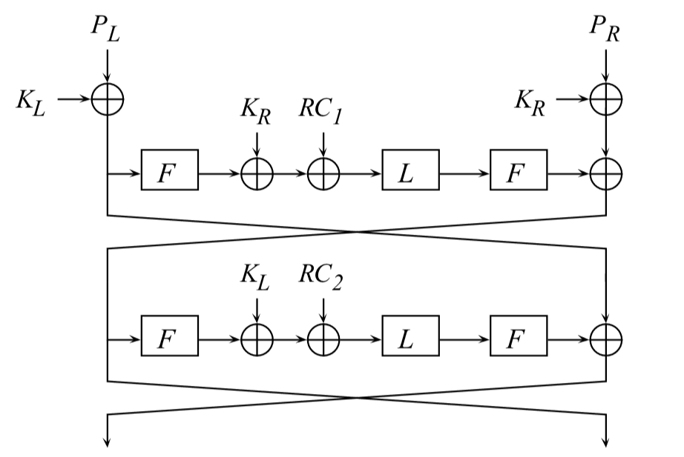
ITUbee Block Cipher
S L S
S L S
S L S
S L S
Halil İbrahim Kaplan
Comparison of MILP solvers

Slide 4
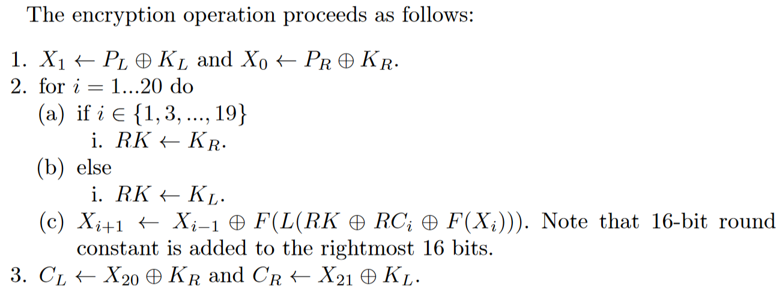
ITUbee Block Cipher
Halil İbrahim Kaplan
Comparison of MILP solvers

Slide 5
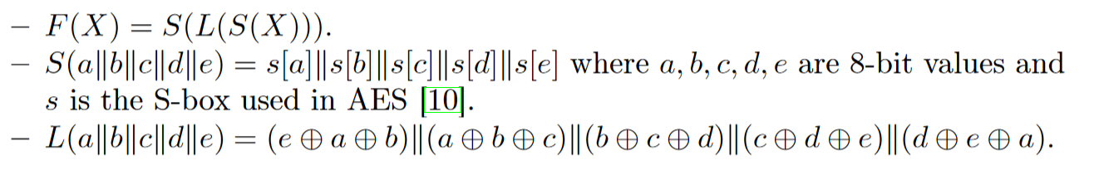
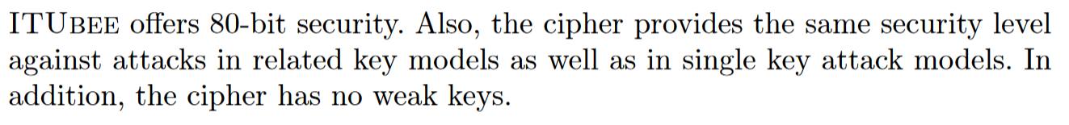
ITUbee Block Cipher
Halil İbrahim Kaplan
Comparison of MILP solvers

Slide 6
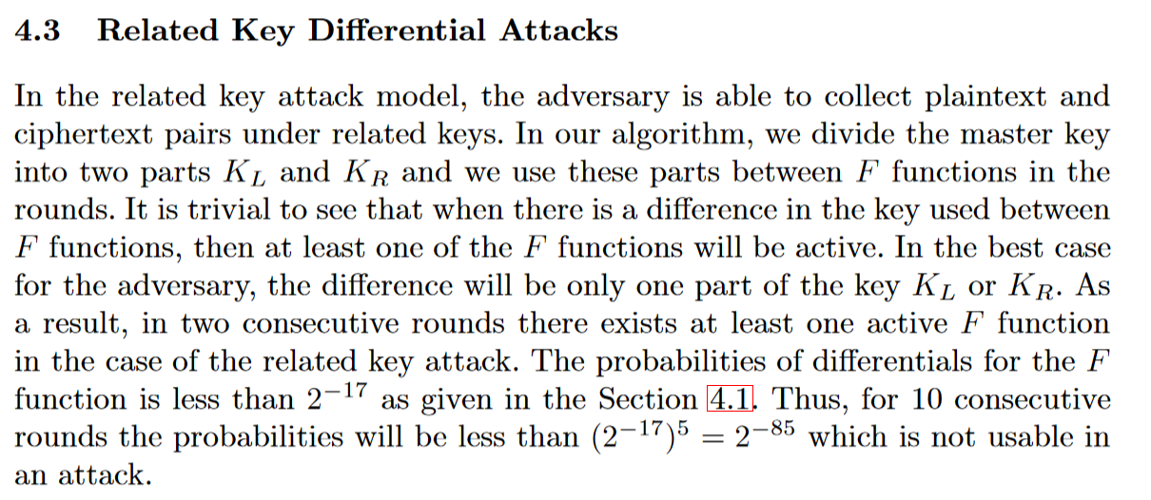

ITUbee Block Cipher
Halil İbrahim Kaplan
Comparison of MILP solvers

Slide 7
MILP Model of Related-Key Differential Attack
R1
R0
KL
KR
KR
R3
R2
R3
R3a
R3b
R3c
R3d
SLS
L
SLS
R4
R4
R3
Minimize: R3 + R3a + R3c + R3d
Halil İbrahim Kaplan
Comparison of MILP solvers

Slide 8
MILP Model of Related-Key Differential Attack
R1
R0
KL
KR
KR
R3
R2
R3
R3a
R3b
R3c
R3d
SLS
L
SLS
R4
R4
R3
Add Constraint : KL + KR $≥$ 1
Halil İbrahim Kaplan
Comparison of MILP solvers

Slide 9
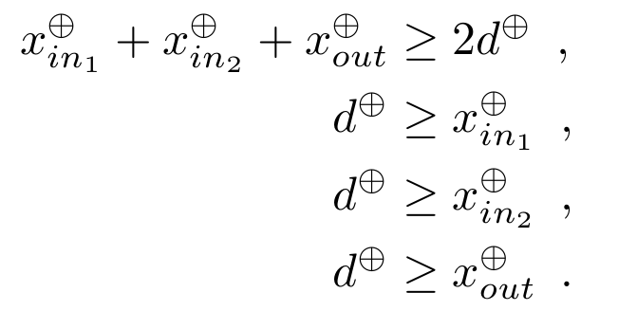
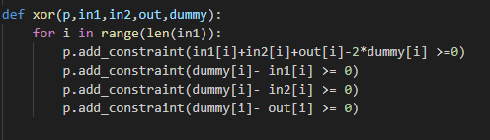
MILP Model of Related-Key Differential Attack
XOR:
Halil İbrahim Kaplan
Comparison of MILP solvers

Slide 10
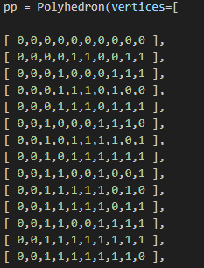
MILP Model of Related-Key Differential Attack
L Function:
Halil İbrahim Kaplan
Comparison of MILP solvers

Slide 11
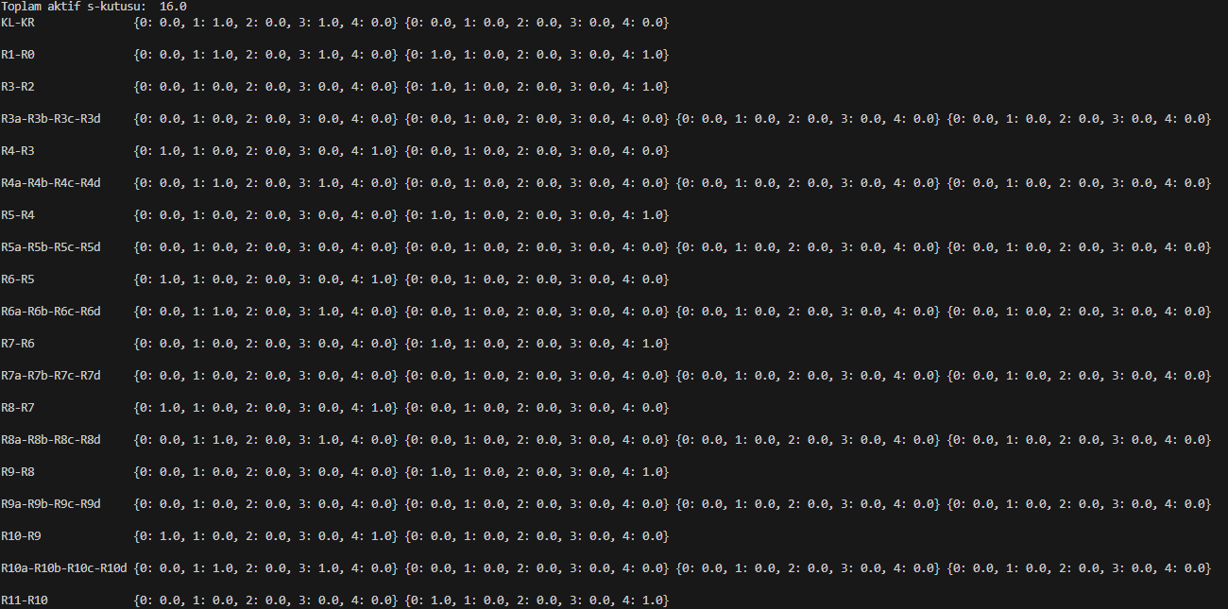
MILP Model of Related-Key Differential Attack
Halil İbrahim Kaplan
Comparison of MILP solvers

Slide 12
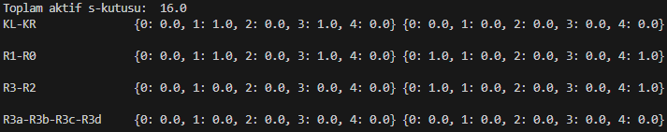
R1
R0
KL
KR
KR
R3
R2
R3
R3a
R3b
R3c
R3d
SLS
L
SLS
R4
R4
R3
Halil İbrahim Kaplan
Comparison of MILP solvers

Slide 13
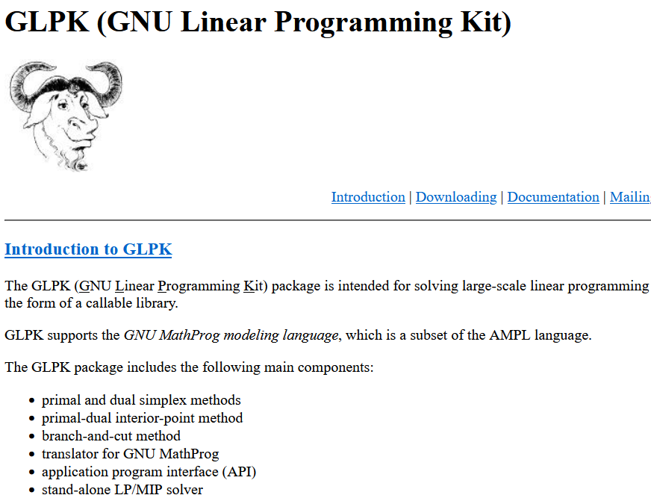
GLPK Solver
Halil İbrahim Kaplan
Comparison of MILP solvers

Slide 14
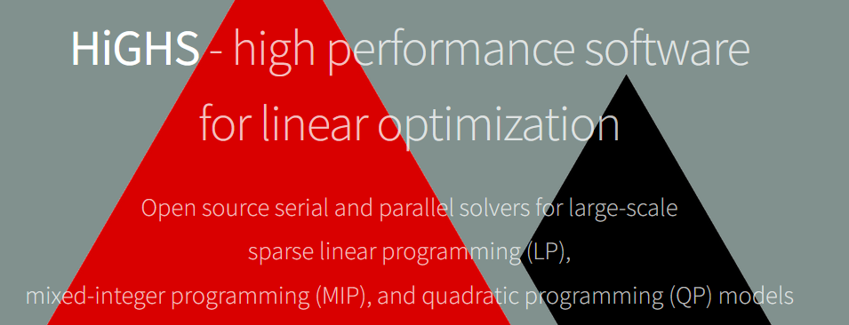
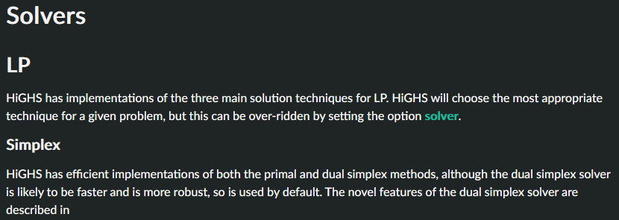
HiGHS Solver
Halil İbrahim Kaplan
Comparison of MILP solvers

Slide 15
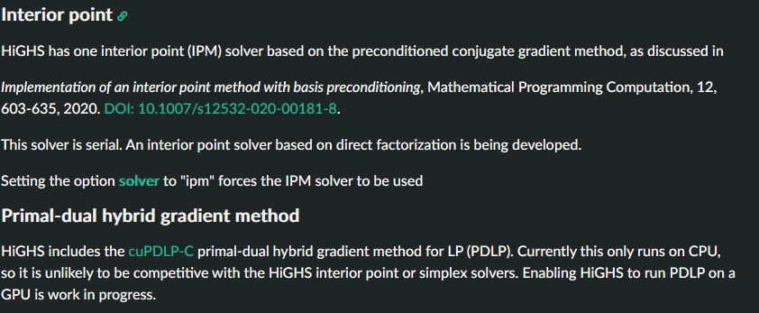
HiGHS Solver
Halil İbrahim Kaplan
Comparison of MILP solvers

Slide 16

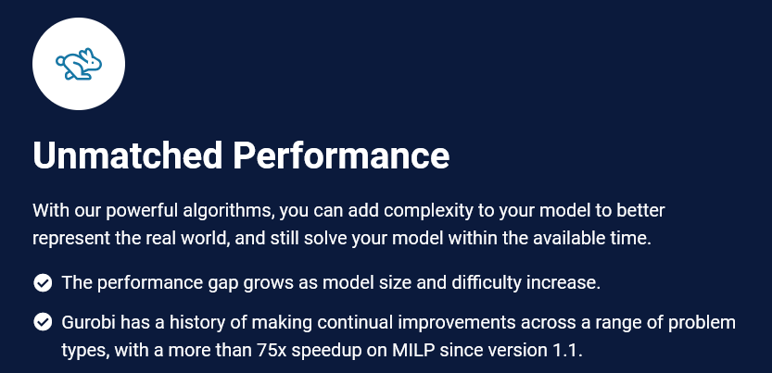
Gurobi Solver
Halil İbrahim Kaplan
Comparison of MILP solvers

Slide 17
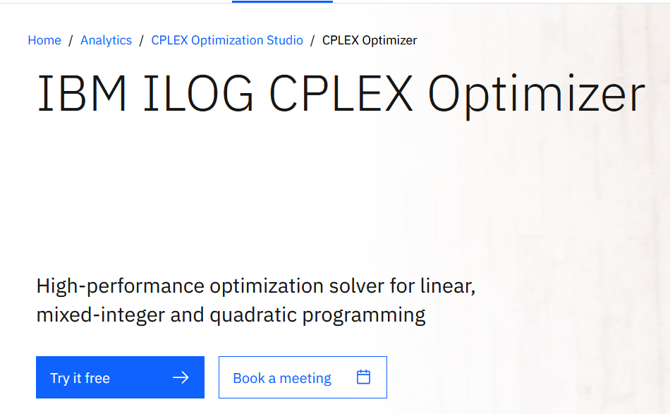
CPLEX Solver
Halil İbrahim Kaplan
Comparison of MILP solvers

Slide 18
Comparison
PROBLEM | SOLVER | TIME(sec) | SPEED
Related-Key Differential Cryptanalysis of ITUbee algoirthm (8 round) 48649 constraints 320 variables | GLPK | 257 | x (base)
 | HiGHS | 231 | 1.1x
 | SCIP | 86 | 2.9x
 | Gurobi | 37 | 6.9x
 | CPLEX | 16 | 16x
CPU: 11th Gen Intel(R) Core(TM) i7-1165G7 @ 2.80GHz
RAM : 32,0 GB
Halil İbrahim Kaplan
Comparison of MILP solvers

Slide 19
Comparison
PROBLEM | SOLVER | TIME(sec) | SPEED
Related-Key Differential Cryptanalysis of ITUbee algoirthm (10 round) 60801 constraints 390 variables | GLPK | 1610 | x (base)
 | HiGHS | 321 | 5x
 | SCIP | 202 | 7.9x
 | Gurobi | 34 | 47x
 | CPLEX | 40 | 40x
CPU: 11th Gen Intel(R) Core(TM) i7-1165G7 @ 2.80GHz
RAM : 32,0 GB
Halil İbrahim Kaplan
Comparison of MILP solvers

Slide 20
Comparison
PROBLEM | SOLVER | TIME(sec) | SPEED
Related-Key Differential Cryptanalysis of ITUbee algoirthm (12 round) 72953 constraints 460 variables | GLPK | 4543 | x (base)
 | HiGHS | 1780 | 2.5x
 | SCIP | 376 | 12x
 | Gurobi | 48 | 94x
 | CPLEX | 53 | 85x
CPU: 11th Gen Intel(R) Core(TM) i7-1165G7 @ 2.80GHz
RAM : 32,0 GB
Halil İbrahim Kaplan
Comparison of MILP solvers

Slide 21
Comparison
CPU: 11th Gen Intel(R) Core(TM) i7-1165G7 @ 2.80GHz
RAM : 32,0 GB
Halil İbrahim Kaplan
Comparison of MILP solvers

Slide 22
Referances
Karakoç, F., Demirci, H., & Harmancı, A. E. (2013). ITUbee: a software oriented lightweight block cipher. In Lightweight Cryptography for Security and Privacy: Second International Workshop, LightSec 2013, Gebze, Turkey, May 6-7, 2013, Revised Selected Papers 2 (pp. 16-27). Springer Berlin Heidelberg.
Mouha, N., Wang, Q., Gu, D., & Preneel, B. (2012). Differential and linear cryptanalysis using mixed-integer linear programming. In Information Security and Cryptology: 7th International Conference, Inscrypt 2011, Beijing, China, November 30–December 3, 2011. Revised Selected Papers 7 (pp. 57-76). Springer Berlin Heidelberg.
Developers, S. (2020). SageMath. the Sage Mathematics Software System (Version 9.0). Retrieved July, 21, 2022.
Gurobi, I. (2013). Gurobi Optimizer 5.0. Gurobi.
Manual, C. U. S. (1987). Ibm ilog cplex optimization studio. Version, 12(1987-2018), 1.
Halil İbrahim Kaplan
Comparison of MILP solvers

